Slide 1
NUOVI FARMACI E TERAPIA PERSONALIZZATA NELLA SCLEROSI MULTIPLA
Dott.ssa Livia Pasquali
Dipartimento di Medicina Clinica e Sperimentale U.O.C Neurologia
Università di Pisa

Slide 2
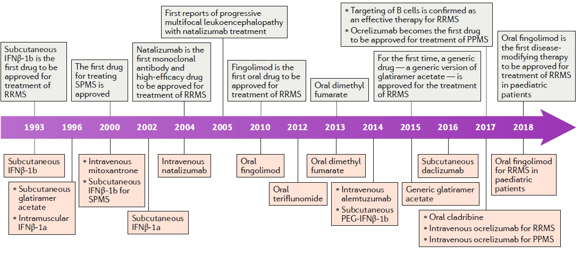
Timeline of developments in the treatment of multiple sclerosis
Tintore et al., Nat Rev Neurol. 2019;15(1):53-58.
Notes:
Qui possiamo vedere lo sviluppo nel tempo delle terapie per la SM. Lo scenario terapeutico si è molto arricchito negli ultimi anni con l’introduzione di farmaci orali e anticorpi monoclonali. In particolare vi parlerò di quelli di più recente introduzione Alemtuzumab, Ocelizumab e Cladribina

Slide 3
Lemtrada®
(Alemtuzumab)
(First course:12 mg daily for 5 days,
Second course (12 months later): 12 mg daily for 3 days
Up to two additional courses, each of 12 mg daily for 3 days, can be given at 12-month intervals).
Notes:
L’alemtuzumab viene somministrato ev per 5 gg e successivamene, dopo un anno per 3 giorni. I cicli possono essere eventualmente ripetuti dopo 12 mesi.

Slide 4
Alemtuzumab: Mechanism of Action
LEMTRADA is a humanized monoclonal antibody that binds to CD52, a cell-surface antigen present on T and B cells
There are three mechanisms by which alemtuzumab mediates immune cell depletion :
-antibody-dependent cell-mediated cytotoxicity;
-complement-dependent cytotoxicity;
-apoptosis
In vitro experiments showed that antibody-dependent cell-mediated cytotoxicity occurs at much lower concentrations of alemtuzumab (0.01 mg/mL) than the concentration required for complement-dependent cytotoxicity and apoptosis.
Notes:
Esso è un anticorpo monoclonale ce si lega al CD52, un Ag di superficie dei LB e LT.

Slide 5
Alemtuzumab
After alemtuzumab administration to MS patients, depletion of
CD52+ cells is observed, mostly lymphocytes, followed by repopulation occurring:
-after about 3 months for monocytes and B cells
-after 30 months for CD8+ T cells
-after 61 months for CD4+ T cells
The changed proportions in immune cells also include an increased number of Tregs and memory T and B cells
Predominant regulatory T cells also create a “tolerogenic” environment after alemtuzumab application.
Long-time CD4+ cell depletion is considered the most important for the therapeutic effect of alemtuzumab.

Slide 6
ALEMTUZUMAB: indicazioni terapeutiche
LEMTRADA è indicato per i pazienti adulti con sclerosi multipla recidivante-remittente (SMRR) con malattia attiva definita clinicamente o attraverso le immagini di risonanza magnetica

Slide 7
CARE-MSI and II (phase III)
-CARE-MSI trial enrolled treatment naïve patients with early RRMS.
-CARE-MSII trial enrolled previously treated patients with RRMS.
-Annual cycles of intravenous alemtuzumab at 12 mg/d or three times per week subcutaneous INF-β1a at 44 μg that was followed for 24 months.

Slide 8
CARE-MS I and II: Results
CARE-MS I: 55% reduction in relapse rate in the alemtuzumab-treated group compared to the INF-β1a group at 24 months
CARE-MS II: 49% reduction in relapse rate in the alemtuzumab-treated group compared to the INF-β1a group at 24 months

Slide 9
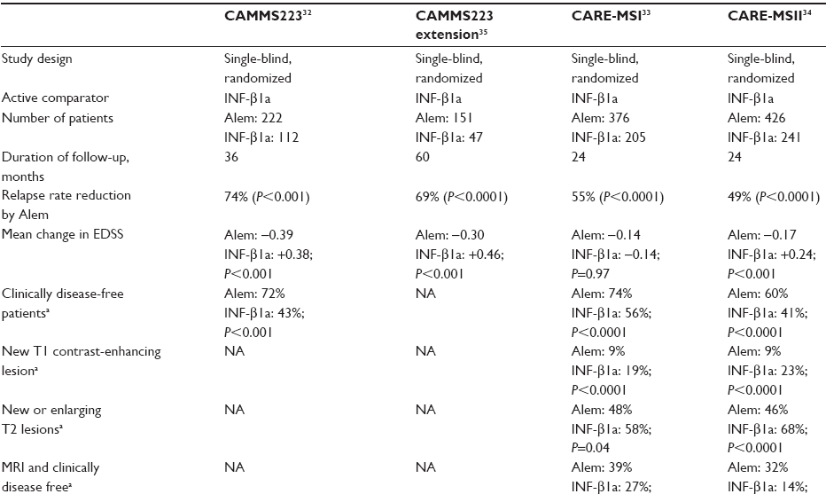
ALEMTUZUMAB
Dubey D et al.,Neuropsychiatr Dis Treat. 2015

Slide 10
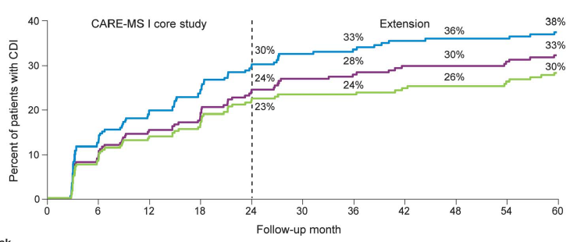
Estensione a 5 anni di CARE-MSI: confirmed disability improvement
Through 5 years, 75.1% of patients were free of 6-month CDW (confirmed disability worsening )
Havrdvova E et al.,Neurology 2017

Slide 11
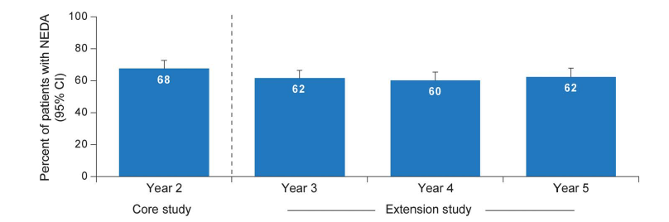
Estensione a 5 anni di CARE-MSI:
NEDA (no evidence of disease activity)
52.9% 54.2% 58.2%
NEDA
- No relapses
- No increase in disability (measured by EDSS)
- No new or active (enhancing) lesions on MRI scans.
Havrdvova E et al.,Neurology 2017

Slide 12
Estensione a 5 anni di CARE-MSII
Havrdvova E et al.,Neurology 2017

Slide 13
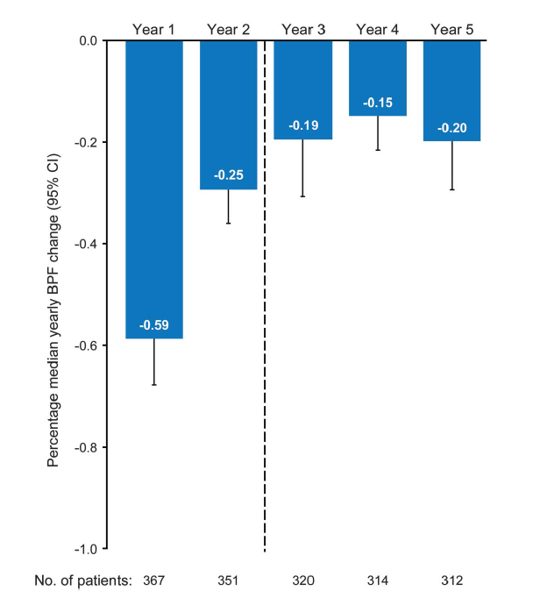
Estensione a 5 anni di CARE-MSII
Brain volume loss over 5 years in alemtuzumab patients
Havrdvova E et al.,Neurology 2017

Slide 14
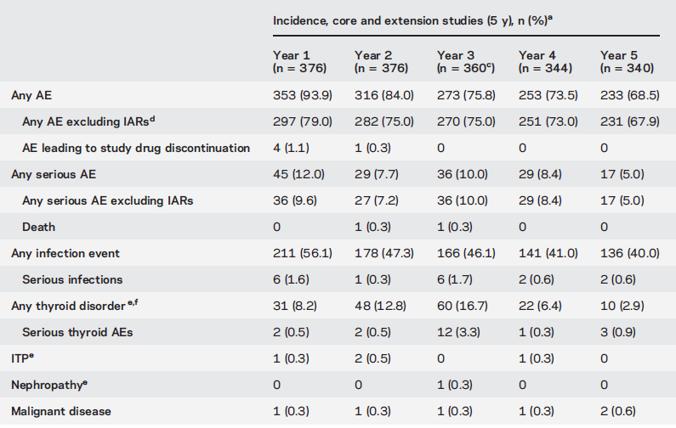
Alemtuzumab: effetti collaterali
tubercolosi attiva e latente, listeriosi/Listeria meningitis, candidiasi
Non sono stati riportati casi di PML
Havrdvova E et al.,Neurology 2017

Slide 15
Alemtuzumab: infusion associated reactions (IARs)
The reactions generally include headache, rash, pyrexia, nausea, flushing, urticaria, insomnia and pruritus.
More than 10% of patients in the Phase III studies showed cardiac disorders, in particular tachycardia.
It is thought that the IARs are due to allergic reactions of hypersensitivity mediated by immunoglobulin E and nonallergic cytokine release reactions induced by the recruitment of inflammatory cells or cell lysis.
IARs decreased with each annual course of treatment and with subsequent infusions within a course.

Slide 16
Ocrevus®
(Ocrelizumab)
-600 mg dose is administered as two separate intravenous infusions, day 1 and day 15
-subsequent doses as a single 600 mg intravenous -infusion (every 6 months)

Slide 17
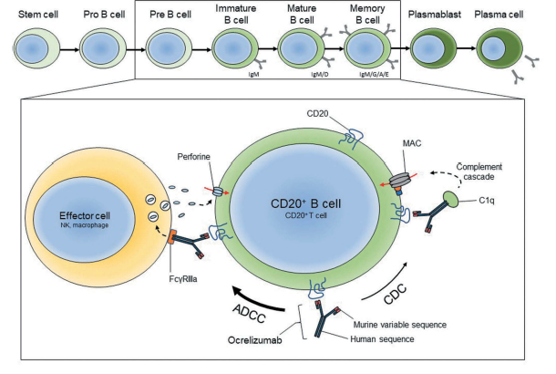
Ocrelizumab: mechanism of action
Ocrelizumab depletes pre-B cells, immature B cells, mature B cells and memory B cells by antibody-dependent cellular cytotoxicity (ADCC) and complement-dependent cytotoxicity (CDC), but not lymphoid stem cells and plasma cells
Bigaut, et al., Expert Review of Neurotherapeutics, 2018

Slide 18
Status of ocrelizumab
Approved by the FDA on 28 March 2017 for
RRMS and PPMS, by the EMA on 8 January 2018 and by Health Canada on 14 February 2018 for RRMS with active disease and for early PPMS .
FDA: ‘Ocrelizumab is indicated for the treatment of adult
patients with relapsing or primary progressive forms of multiple
sclerosis.’
EMA: ‘Ocrelizumab is indicated for the treatment of adult
patients with relapsing forms of multiple sclerosis (RMS) with
active disease defined by clinical or imaging features.
Ocrelizumab is indicated for the treatment of adult patients
with early primary progressive multiple sclerosis (PPMS) in
terms of disease duration and level of disability, and with
imaging features characteristic of inflammatory activity.’

Slide 19
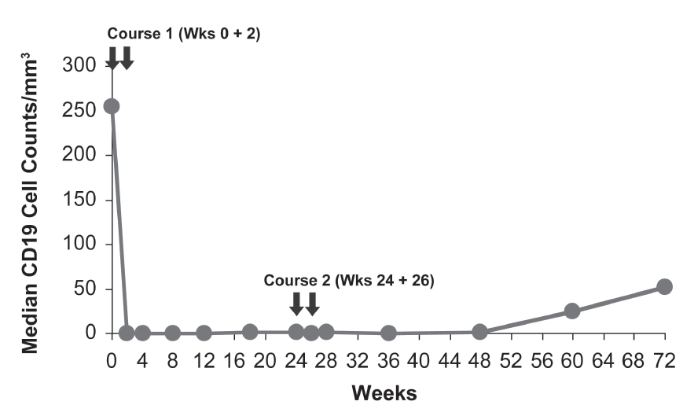
B Cell Depletion: Anti-CD20 Therapy
Ocrelizumab RA Study¹
Rituximab MS Study²
CD19+ B Cells
Chronic anti-CD20 treatment with ocrelizumab results in persistent immunosuppression, under which B cells remain depleted
The long-term consequences of anti-CD20 treatment with ocrelizumab in patients with MS are unknown
1. Adapted from Genovese, et al. Arthritis Res Ther. 2013;15(suppl 1):S4; 2. Bar-Or A, et al. Ann Neurol. 2008;63:395-400.

Slide 20
Baseline Characteristics in 2-Year Core Studies:
Ocrelizumab vs SC IFNß-1a
 | Clinical trial
Trial | IFN ß-1a | OPERA I | IFN ß-1a | OPERA II
Number of Patients | 411 | 410 | 418 | 417
Female sex (%) | 66.2 | 65.9 | 67.0 | 65.0
Baseline EDSS | 2.75±1.29 | 2.86±1.24 | 2.84±1.38 | 2.78±1.30
Mean relapses in prior year | 1.33±0.64 | 1.31±0.65 | 1.34±0.73 | 1.32±0.69
Mean duration of symptoms (yr) | 6.25±5.98 | 6.74±6.37 | 6.68±6.13 | 6.72±6.10
Previously untreatedª % | 71.4 | 73.8 | 75.3 | 72.9
ªUntreated with disease-modifying therapy in 2 years before screening. EDSS=Expanded Disability Status Scale
Note: Patient characteristics represent pooled data for study drug and comparator
Hauser SL, et al. N Engl J Med. 2017;376:221-234

Slide 21
ARR for Ocrelizumab vs SC IFNß-1a at 2 Years
 | OPERA I | OPERA II
% Reduction ARR | 46% (P < 0.001) | 47% (P < 0.001)
Absolute Relapse Rate Reduction | 0.13 (0.16 vs 0.29) | 0.13 (0.16 vs 0.29)
Absolute risk reduction (ARR) is the difference in event rates between treatment and control groups (ie, response to treatment - response to placebo = absolute risk reduction)
Favorable reductions in relapses demonstrated in patients treated with ocrelizumab over 2 years
No long-term data on sustained reduction in ARR is available for ocrelizumab past the
96-week core Phase 3 studies
Absolute relapse rate reduction and NNT determined from published ARR in citations listed below.
Hauser SL, et al. N Engl J Med. 2017;376:221-234

Slide 22
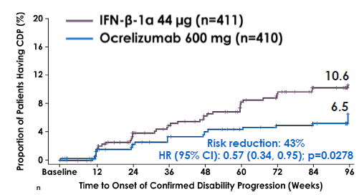
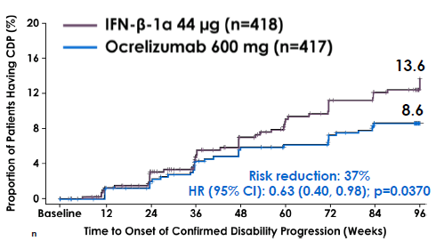
Tertiary Endpoint^{1,2}
OPERA I
OPERA II
43% reduction vs SC IFNß-1a
P = 0.0278
37% reduction vs SC IFNß-1a P = 0.0370
Ocrelizumab 600 mg
Ocrelizumab 600 mg
CDW and CDP are defined as an increase of ≥1 point in EDSS from baseline (1.5 points when baseline EDSS is 0) persisting for at least 24 weeks (OPERA)
CDW=Conformed Disability Worsening; CDI=Confirmed Disability Improvement
1. Hauser SL, et al. ECTRIMS 2015 Platform 190; 2. Hauser SL, et al. N Engl J Med. 2017;376:221-234.

Slide 23
Secondary Endpoint¹
Secondary Endpoint¹
77% reduction
P < 0.001
83% reduction
P < 0.001
94% reduction
P < 0.001
95% reduction
P < 0.001
411
n = 411 410 418 417
1. Hauser SL, et al. N Engl J Med. 2017;376:221-234.

Slide 24
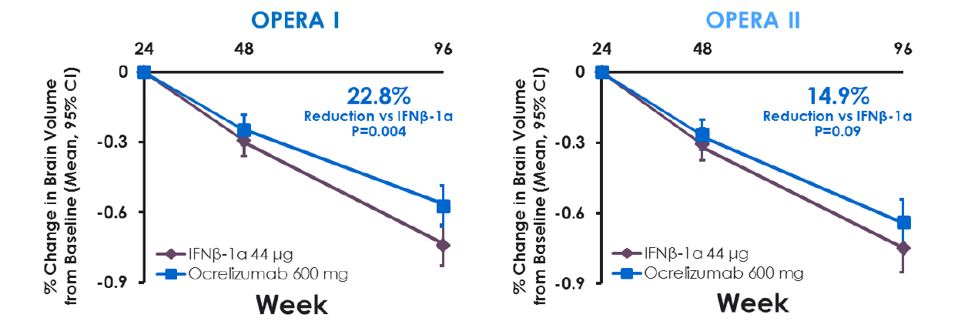
Brain Atrophy Data for Ocrelizumab
Hauser SL et al. N Engl J Med. 2017;376(3):221-234

Slide 25
Rationale for Ocrelizumab ORATORIO Design
OLYMPUS trial: rituximab in primary progressive multiple sclerosis (PPMS)
Rituximab did not meet primary endpoints in PPMS, but subgroup analysis demonstrated an efficacy in young patients (<51 years) with Gd⁺ lesions¹
Moving ocrelizumab to Phase 3 PPMS: learning from the OLYMPUS trial
Modified inclusion/exclusion criteria to select active population from OLYMPUS trial
OLYMPUS impact on ocrelizumab PPMS Phase 3 trial
Selected younger patients
Selected patients with active disease
Increased length of treatment to 2.5 years
0.7
Treatment Group
Modified Criteria (n = 225)
0.6
Placebo
Rituximab
0.5
Hazard Ratio: 0.53
(95% CI: 0.33 – 0.87)
0.4
Proportion of Patients With CPD
P = 0.0100
0.3
0.2
0.1
0.0
0
12
24
36
48
60
72
84
96
108
Time to Confirmed Disease Progression (weeks)
1. Hawker K, et al. Ann Neurol. 2009;66:460-471. 2. Montalban X, et al. N Engl J Med. 2017;376:209-220.
Notes:
A previous phase 2–3 trial of the chimeric monoclonal anti-CD20 antibody rituximab (OLYMPUS trial) in primary progressive multiple
sclerosis did not meet its primary efficacy end point, but a subgroup analysis showed delayed progression of disability in younger patients (<51 years of age) with evidence of increased inflammatory disease activity.3 Those results provided the rationale and in part informed the trial design for this investigation of ocrelizumab in patients with primary progressive multiple sclerosis. Here,
we report results from a phase 3, randomized, parallel-group, double-blind, placebo-controlled trial (ORATORIO) that investigated the efficacy
and safety of ocrelizumab in patients with primary
progressive multiple sclerosis.

Slide 26
ORATORIO PPMS Study Results: Summary^{1,2}
 | 2x300 mg IV (600mg) q24w vs placebo, 120 weeks
% reduction in risk of 12-week Confirmed Disability Progression (CDP) | 24% reduction vs placebo, P = 0.0321
% reduction in risk of 24-week CDP | 25% reduction vs placebo, P = 0.0365
% change in T25FW from baseline to week 120 | 29% reduction vs placebo, P = 0.0404
% change in T2 lesion volume from baseline to week 120 | 3.4% ocrelizumab vs 7.4% placebo, P < 0.001
Brain Volume Loss (24-120 weeks) | 17.5% reduction vs placebo, P = 0.0206
% mean change in SF-36 Physical Component Summary Score from baseline to week 120 | 0.38% reduction vs placebo, P = 0.60
1. Montalban X, et al. N Engl J Med. 2017;376:209-220; 2. Montalban X, et al. ECTRIMS 2015 Platform presentation 228

Slide 27
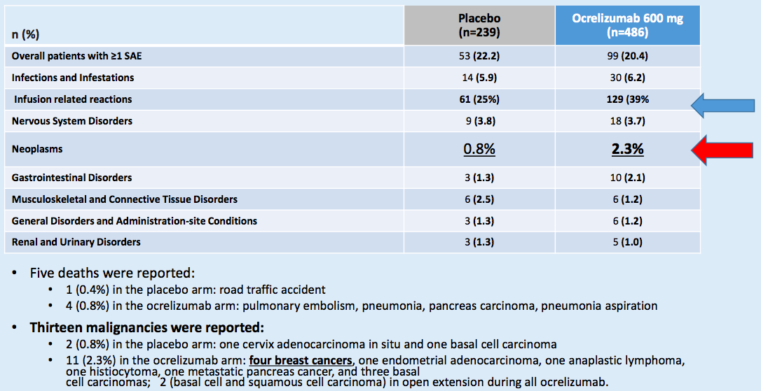
ORATORIO SIDE EFFECTS

Slide 28
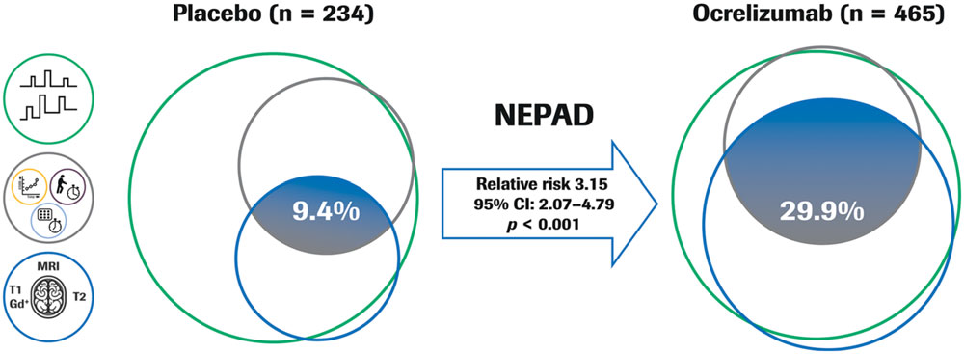
no evidence of progression or active disease (nepad)
IN ORATORIO
NEPAD: no evidence of progression, no brain magnetic resonance imaging activity, no protocol defined relapse
Compared to placebo, ocrelizumab enhanced 3-fold the proportion of PPMS patients with no evidence
of either progression or inflammatory disease activity.
Wolinsky et al., ANN NEUROL 2018;84:527–536

Slide 29
Mavenclad®
(Cladribine)
(3.5 mg/kg body weight over 2 years, administered as 1 treatment course of 1.75 mg/kg per year)

Slide 30
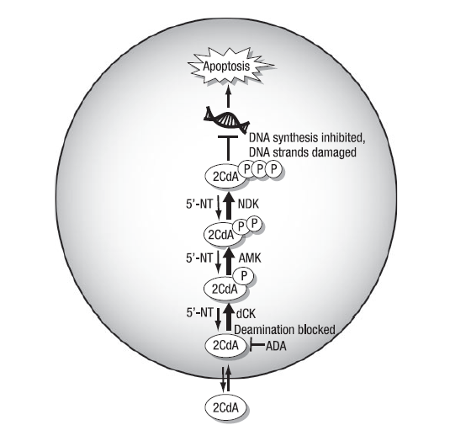
Proposed MOA of Cladribine in MS
Cladribine enters the cell via purine nucleoside transporters and is phosphorylated to its active form (2-CdATP) by deoxycytidine kinase (dCK)¹
Lymphocytes, particularly CD4+ and CD8+ T cells, have the highest dCK to 5’-nucleotidase ratio of any cell type in the body²
Preferential accumulation of 2-CdATP in lymphocytes disrupts cellular metabolism and damages DNA, causing apoptosis¹
Figure: Rammohan KW and Shoemaker J, Neurology. 2010;74:S547.
1. Kim W, et al. J Clin Neurol. 2015;11:9; 2. Leist TP, et al. Clin Neuropharmacol. 2011;34:28.

Slide 31
Clinical Development of Cladribine¹
 | 2005 | 2006 | 2007 | 2008 | 2009 | 2010 | 2011 | 2012 | 2013 | 2014 | 2015 | 2016 | 2017 | 2018
CLARITY² Pivotal Phase 3 monotherapy trial
ONWARD Phase 2 study to evaluate safety and efficacy of cladribine + IFNβ in active MS
ORACLE MS³ Phase 3 RCT to evaluate efficacy and safety of 2 doses of cladribine vs placebo in patients at risk of developing MS
CLARITY Extension Phase 3 extension study of CLARITY
PREMIERE Prospective long-term safety registry
2 years
n = 1326
1 year
n = 214
2 years
n = 617
4 years
n = 867
8 years
n = 1190
1. www.clinicaltrials.gov; 2. Giovannoni G, et al. N Engl J Med. 2010;362:416-426; 3. Leist TP, et al. Lancet Neurol. 2014;13:257-267.

Slide 32
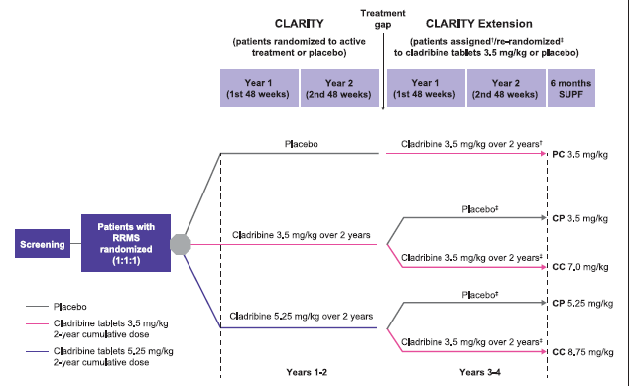
Each short course of treatment comprised one or two 10-mg cladribine tablets taken once daily for four or five consecutive days or an equivalent number of matching placebo tablets. There was a variable interval between the treatment periods in the CLARITY and Extension studies.
Giovannoni, MSJ 2019

Slide 33
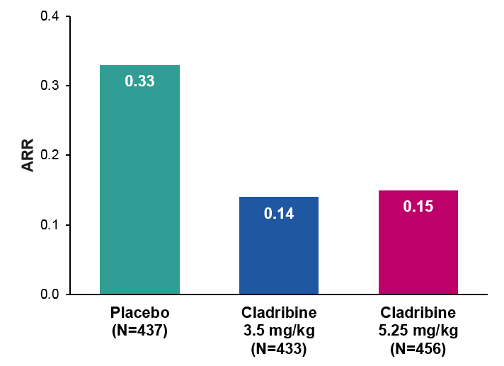
CLARITY: Clinical Outcomes
Annualized Relapse Rate (ARR)
3-Month Confirmed Disability Worsening
RR: 54.5%
P < 0.001
5.25 mg/kg vs placebo:
HR: 0.69; 95% CI: 0.49-0.96; P = 0.026
3.5 mg/kg vs placebo:
HR: 0.67; 95% CI: 0.48-0.96; P = 0.018
RR: 57.6%
P < 0.001
25
20
21.6%
15.1%
15
14.3%
Patients with 3-mo confirmed
EDSS progression (%)
10
Cladribine 5.25 mg/kg
P = 0.03
5
Cladribine 3.5 mg/kg
P = 0.02
0
0
12
12
36
48
60
72
84
96
Weeks
CLARITY showed that treatment with oral cladribine significantly reduced relapse rates and risk of confirmed disability worsening in patients with RRMS
CI, confidence interval; HR, hazard ratio; RR, relative reduction
Giovannoni G, et al. N Engl J Med. 2010;362:416-426.
Notes:
In the first 48-week treatment period, patients received either two courses of cladribine, followed by two courses of placebo (in the 3.5-mg group); four courses of cladribine (in the 5.25-mg group); or four courses of placebo (in the placebo group), starting at day 1 and at weeks 5, 9, and 13 (8 to 20 days of treatment). In the second 48-week period, both cladribine groups received two courses
of cladribine, and the placebo group received two courses of placebo, starting at weeks 48 and 52 (8 to 10 days of treatment)

Slide 34
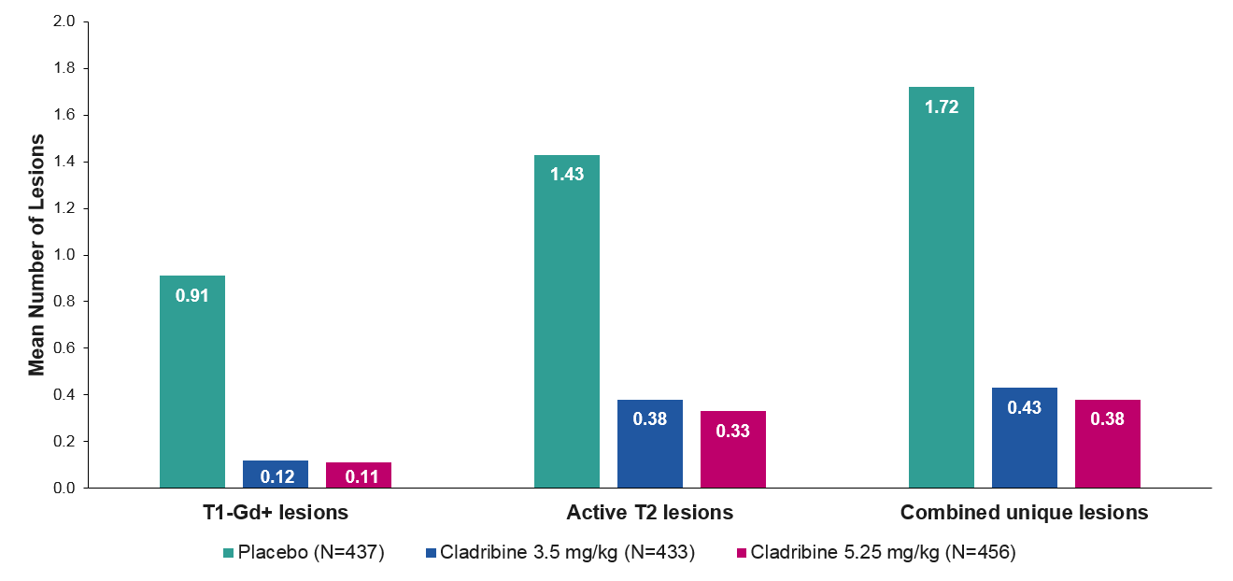
CLARITY: MRI Outcomes
RR: 76.9%
P < 0.001
RR: 77.9%
P < 0.001
RR: 74.4%
P < 0.001
RR: 73.4%
P < 0.001
RR: 87.9%
P < 0.001
RR: 85.7%
P < 0.001
Treatment with oral cladribine significantly reduced MRI measures of
disease activity in patients with RRMS
RR, relative reduction
Giovannoni G, et al. N Engl J Med. 2010;362:416-426.

Slide 35
CLARITY: Safety Overview
Incidence (%) | Placebo (n = 435) | Cladribine 3.5 mg/kg (n = 430) | Cladribine 5.25 mg/kg (n = 454)
Any AE | 73.3 | 80.7 | 83.9
AEs leading to discontinuation | 2.1 | 3.5 | 7.9
Serious AEs | 6.4 | 8.4 | 9.0
Infections | 1.6 | 2.3 | 2.9
Neoplasms | 0 | 1.4 | 0.9
Deaths | 0.5 | 0.5 | 0.4
Most common AEs: lymphopenia, headache, nasopharyngitis
Herpes zoster infections in 20 (2.3%) cladribine-treated patients (0 in placebo group); reactivation of latent tuberculosis in 1 patient (subsequently died)
Neoplasms (all in cladribine-treated patients): 4 cases of cancer (1 melanoma, 1 each of cervical, pancreatic, and ovarian carcinomas); 5 benign uterine leiomyomas; additional choriocarcinoma in 1 cladribine-treated patient 9 months after study completion
Giovannoni G, et al. N Engl J Med. 2010;362:416-426.

Slide 36
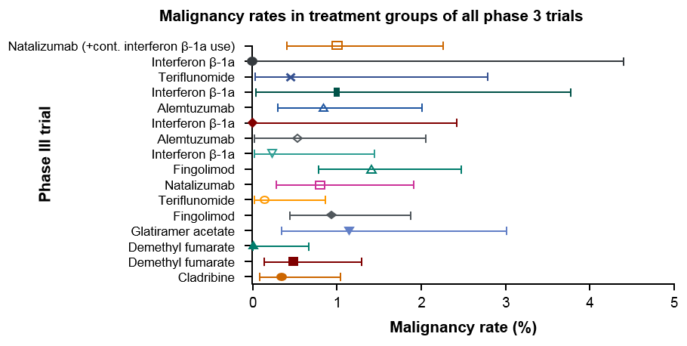
Safety: Malignancies
Meta-analysis investigated the perceived increased cancer risk with cladribine that led to EMA license refusal in 2013
  Treatments compared included cladribine, DMF, fingolimod, teriflunomide, natalizumab, alemtuzumab, and glatiramer acetate
Cancer rate in the CLARITY treatment group (0.34%) was not increased vs treatment groups for other DMTs, whether including placebo-controlled trials only (0.6%, P = 0.4631) or all trials, i.e., including those with an active comparator arm (0.67%, P = 0.3669)
No difference was detected between cancer rates in the treatment groups of CLARITY (0.34%) and ORACLE MS (0.49%) (P = 0.6546)
Pakpoor J, et al. Neurol Neuroimmunol Neuroinflamm. 2015;2:e158.

Slide 37
CLARITY EXTENSION: safety and efficacy
Lymphopenia Grade 3 rates were higher with cladribine than placebo; >90% of those treated with cladribine 3.5 mg/kg recovered to Grade 0–1 by study end.
Cladribine treatment in CLARITY efficacy improvements were maintained in patients treated with placebo in the Extension; in patients treated with cladribine 3.5 mg/kg in CLARITY, approximately 75% remained relapse-free when given placebo during the Extension.
Cladribine tablets treatment for 2 years followed by 2 years’ placebo treatment produced durable clinical benefits similar to 4 years of cladribine treatment with a low risk of severe lymphopenia or clinical worsening.
Giovannoni G et al., Mult Scler. 2018 Oct;24(12):1594-1604.

Slide 38
CLARITY EXTENSION: MRI Outcomes
Treatment with CT 3.5 mg/kg has a durable effect on MRI outcomes.
The mean numbers of T1 Gd+ lesions remained well below CLARITY baseline across all treatment groups, including the CP groups, which had a higher mean number of T1 Gd+ lesions than the CC groups.
Furthermore, the majority of patients in each treatment group remained free from T1 Gd+ lesions, even without retreatment after 2 years.
Comi G et al., Ther Adv Neurol Disord. 2018 Jan 23;11

Slide 39
Mavenclad: pubblicato il 19/3 in G.U.
Indicazioni terapeutiche autorizzate: pazienti con SMRR ad elevata attività di malattia definita da caratteristiche cliniche o di RMN
pazienti con 1 recidiva nell’anno precedente e almeno 1 lesione Gd+ in T1 o 9 o più lesioni in T2 durante la terapia con altri DMD;
pazienti con 2 o più recidive nell’anno precedente, in trattamento con DMD o meno

Slide 40
PERSONALIZZAZIONE DELLA TERAPIA
  Individuare la terapia iniziale: escalation o induction (immune reconstitution therapy)
  Monitorare la risposta alla terapia
  Quando cambiare/sospendere il trattamento
  Scegliere le terapie successive
  Come gestire la terapia in situazioni particolari (es. gravidanza)
Notes:
Ci sono alcuni punti che dobbiamo considerare nell’approccio terapeutico con il paziente

Slide 41
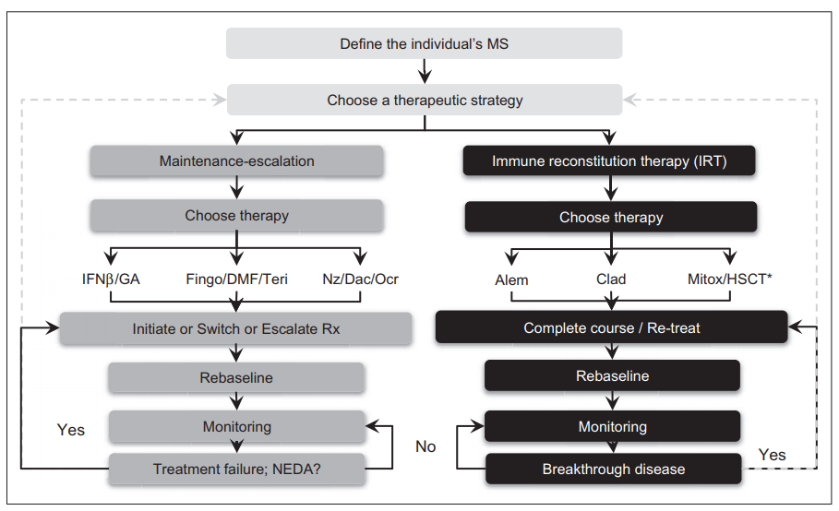
Treatment algorithm
Giovannoni G. Curr Opin Neurol. 2018 Jun;31(3):233-243.

Slide 42
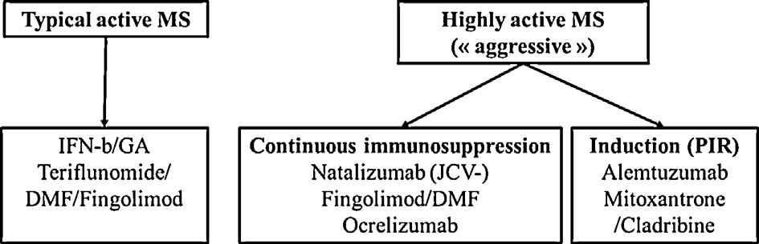
Paziente naïve
Attività clinica e di RMN nei 12 mesi precedenti
Somministrazione continua di un trattamento ad elevata efficacia
Intensa immunosoppressione per tentare di resettare il sistema immunitario “naive” ai trattamenti
Sormani et al., Neurology, 2017; Prosperini et al., J Neurol 2017; Hardova et al., AAN 2018; Giovannoni et al., MSJ 2018

Slide 43
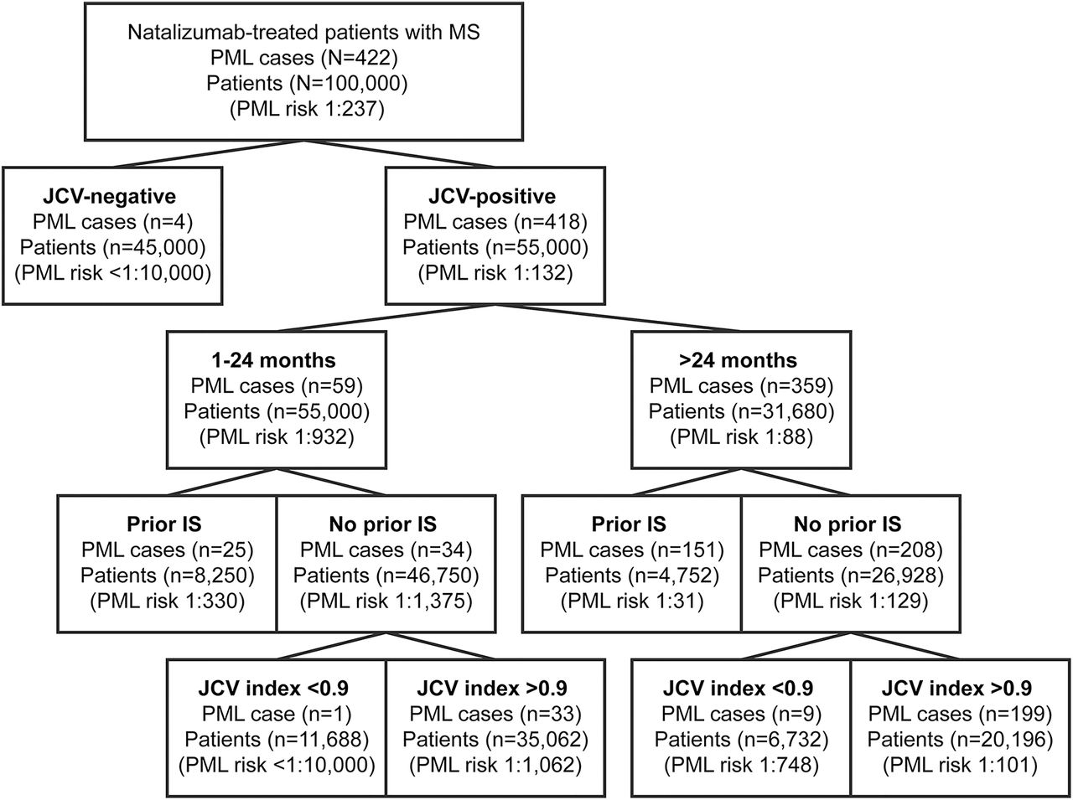

Combination of Validated PML Risk Factors and Resulting Risks
Schwab N, et al. Neurology. 2017;88:1197-1205.

Slide 44
Four factors known to increase the risk of PML in
patients treated with Tysabri®
Longer treatment duration, especially beyond 2 years; limited experience in patients who have received >4 years of Tysabri ® treatment¹
Prior treatment with an immunosuppressant
(eg, mitoxantrone, azathioprine, methotrexate, cyclophosphamide, or mycophenolate mofetil)¹
Presence of anti-John Cunningham Virus (JCV) antibodies; patients who are anti-JCV antibody positive have a higher risk; patients with negative anti-JCV antibody test should be retested every 6 months as per Tysabri SmPC¹
Natalizumab treatment in itself is associated with a significant and substantial increase in anti-JCV antibody index over time²
1. Tysabri SmPC; Biogen, Last updated May 2017. 2. Raffel J et al. Mult Scler. 2015;21(14):1833-38.

Slide 45
NEDA: NO EVIDENT DISEASE ACTIVITY
NEDA 1/2, clinical only (relapse-free and/or progression free);
NEDA-3, clinical and focal MRI activity;
NEDA-4/5, clinical and focal MRI activity free and normalising brain atrophy loss and normalisation of CSF neurofilament levels.

Slide 46
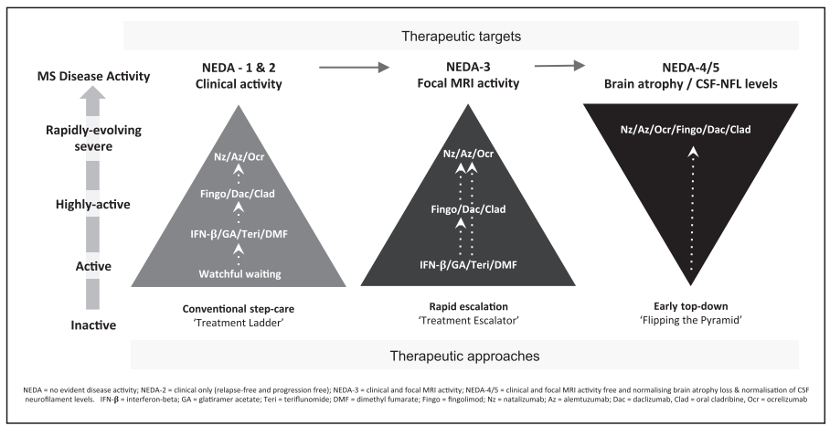
THERAPEUTIC TARGETS AND APPROACHES
Giovannoni, Curr Opin Neurol.2018 Jun;31(3):233-243.

Slide 47
Use and safety of disease-modifying therapy in pregnant women with multiple sclerosis.
MacDonald SC et al., Pharmacoepidemiol Drug Saf. Apr2019;28(4):556-560.
-1649 women with MS; 35% had a prescription for a DMT in the 90 days before pregnancy.
-The most commonly dispensed therapies, glatiramer acetate and interferon beta, are recommended for use until a pregnancy is confirmed and continued only if strongly indicated.
-Natalizumab, used in 4% of our cohort prepregnancy, is prescribed to patients with more active or refractory disease. Again, use in pregnancy is not recommended but is tolerated in cases of refractory disease.

Slide 48
Natalizumab exposure during pregnancy in multiple sclerosis: a systematic review.
Peng A et al., J Neurol Sci. 2019 Jan 15;396:202-205.
Natalizumab exposure during pregnancy does not seem to increase the spontaneous abortion rate but may slightly increase the birth defect rates in women with MS.
Hematologic alterations and low birth weight were common in infants who were exposed to natalizumab during late pregnancy.

Slide 49
MS drugs and pregnancy
Large molecules without specific carriers. Little probability that they can cross the placental barrier in large amounts. In Italy recommendation to continue until pregnancy is confirmed.
Interferon beta 1a
Interferon beta 1b
Glatiramer acetate
Fingolimod
Teriflunomide
Dimethylfumarate
Small molecules, can almost certain cross the placental barrier. In Italy recommandation that these drugs should be discontinued and contraception continued for an appropriate period of time before undergoing pregnancy

Slide 50
Immunosuppression and pregnancy
Generally not recommended as the immunosuppressive agent is present within the body continuously. Safety in pregnancy depends on the safety profile of individual agent
Continuous immunosuppression
Generally well tolerated after the immune system has been reconstituted. The exception being delayed secondary autoimmune complications associated with alemtuzumab; these tend to be antibody mediated disorders and the transfer of autoantibodies across the placenta can cause neonatal disease, for example neonatal hyperthyroidism
Intermittent immunosuppression

Slide 51
CONCLUSIONI
- 1993: prima terapia disponibile (interferone)
- negli ultimi anni notevole incremento delle disease-modifying therapies (DMTs) approvate dall’ EMA, sia iniettabili che orali .
Le nuove terapie disponibili danno l’opportunità di effettuare una “terapia individualizzata” nella quale il paziente e il medico devono considerare l’efficacia, gli effetti collaterali e i danni potenziali in un processo decisionale condiviso.
La molteplicità dei meccanismi d’azione, le diverse necessità di monitoraggio, il diverso profilo di rischio oltre alle conoscenze limitate di alcuni farmaci, rendono complesso il compito di personalizzare la terapia

