Slide 1

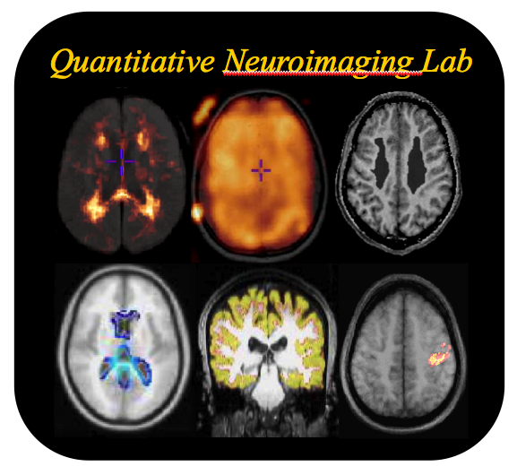
Il Monitoraggio MRi del follow up dei pazienti con Sclerosi Multipla:
priorita’, standardizzazione e analisi delle immagini
Maria Laura Stromillo
Department of Medicine, Surgery and Neuroscience
University of Siena, Italy

Slide 2
MRI in MS
Monitoring disease progression
Monitoring treatment efficacy and safety
Guidelines

Slide 3
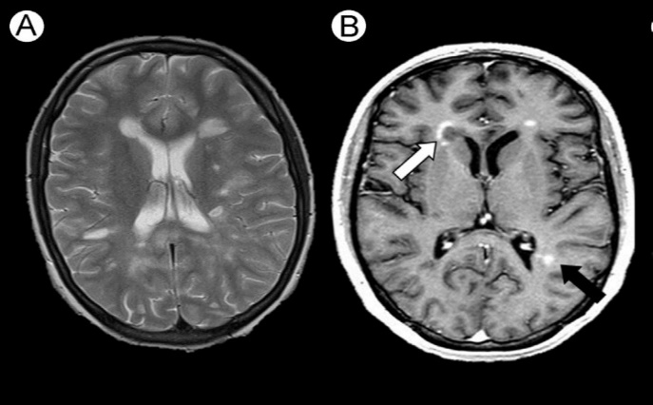
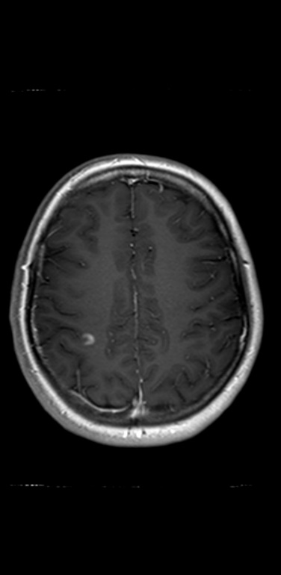
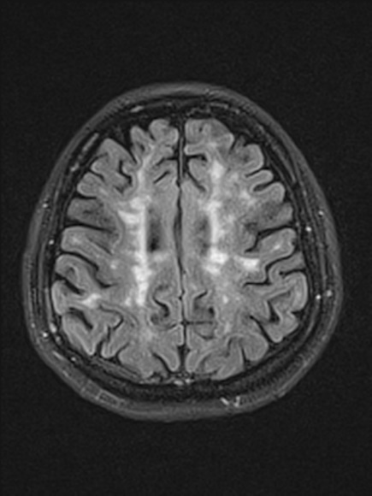
Lesion-derived measures
Outcomes that measure the occurrence of new lesional activity
New and/or enlarging T₂ lesions
New T₁ Gd-enhancing lesions
Number of combined unique active (CUA) lesions
          Outcomes that quantify lesion volumes
          T₂ hyperintense lesion volume
          T₁ hypointense lesion volume
          Gd-enhancing lesion volume
Outcomes that estimate inflammatory activity as a binary phenomenon
The proportion of patients with or without Gd-enhancing lesions
Kaunzner U et al. 2017; Tur C et al, Nat Reviews 2018; Giorgio a et al. Neur Clin 2018
Notes:
Lesion-derived measures can be divided into three categories: outcomes that measure the occurrence of new lesional activity during a given period, such as the number of new and/or enlarging T2 lesions or new T1 gadolinium-enhancing lesions; outcomes that quantify the T2 hyperintense, T1 hypointense or gadolinium-enhancing total lesion volume; and outcomes that estimate inflammatory activity as a binary phenomenon, such as the proportion of patients with or without gadolinium-enhancing lesions. Composite MRI measures could also be included within the group of outcomes that measure new acute lesional activity. For example, the number of combined unique active (CUA) lesions is defined as all new or enlarging T2 lesions or new gadolinium-enhancing lesions, provided that the same focal lesion is counted only once. This end point describes the total number of active lesions in the widest sense and was already used in the first clinical trials in RRMS.
Slide provided by client

Slide 4
MS Lesion & Disability
There is evidence that MRI lesion activity in early disease has prognostic value for estimating disability progression in natural history cohorts^{1,2}
Baseline MRI lesion number and clinical status at 20 years: proportion of patients reaching EDSS score ≥6.0¹
50
40
30
20
10
0
45
35
Patients reaching
EDSS score ≥6.0 (%)
18
6
n=31
n=20
n=22
n=34
≥10 4–9 1–3 0
Number of baseline lesions
Fisniku LK et al. Brain 2008
Brex PA et al. N Engl J Med 2002
Notes:
Abbreviations:
EDSS, Expanded Disability Status Scale; MRI, magnetic resonance imaging
References:
1. Fisniku LK et al. Disability and T2 MRI lesions: a 20-year follow-up of patients with relapse onset of multiple sclerosis. Brain 2008;131:808–17
2. Brex PA et al. A Longitudinal Study of Abnormalities on MRI and Disability from Multiple Sclerosis. N Engl J Med 2002;346:158−64
4

Slide 5
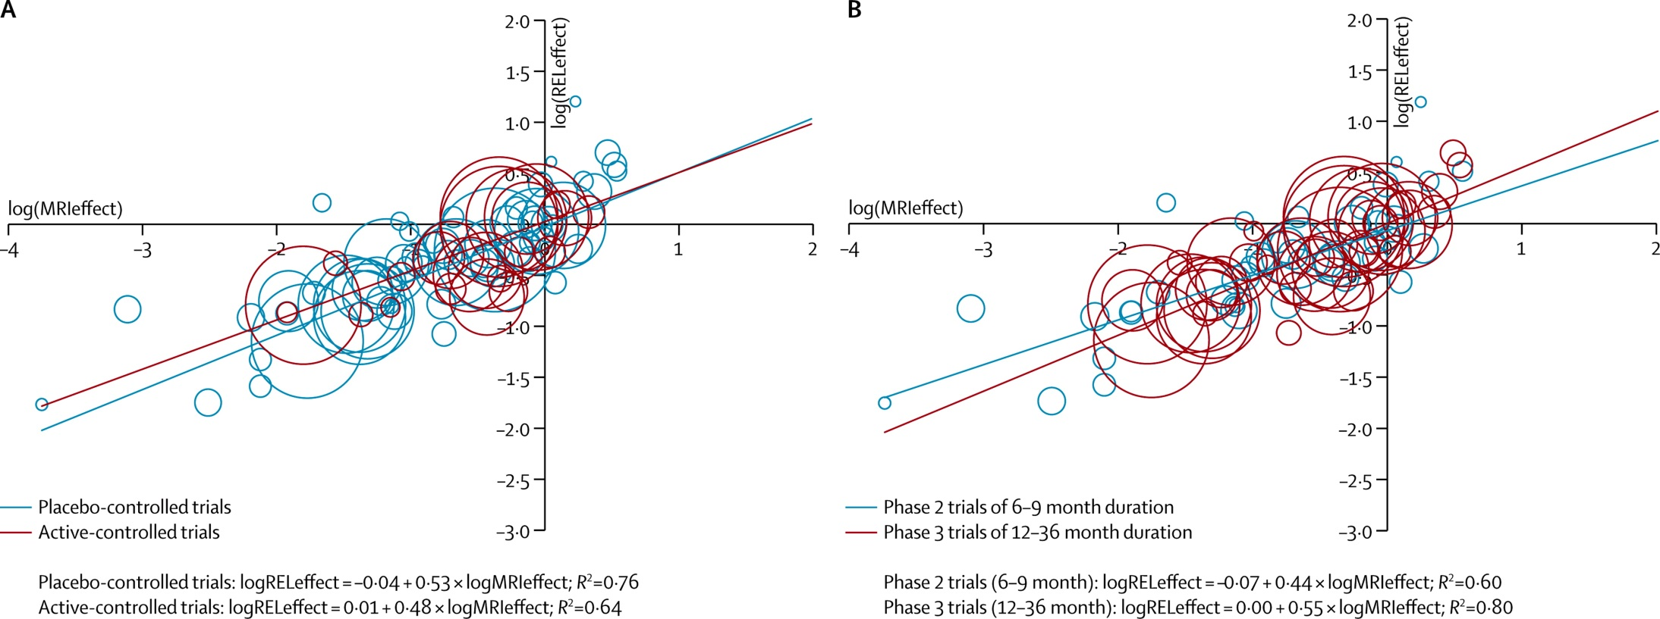
MS Lesions
Meta-analysis of 31 trials (18901 RRMS patients)
Correlation between active lesions and relapse rate
Placebo-controlled trials
R² = 0.76
Phase 2 trials (6-9 months)
R² = 0.60
Active-controlled trials
R² = 0.64
Phase 3 trials (12-36 months)
R² = 0.80
Sormani et al., Lancet Neurol 2013

Slide 6
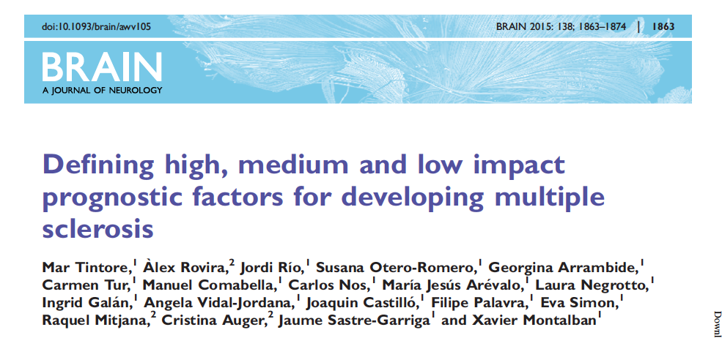
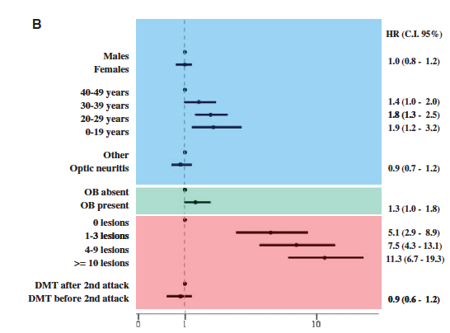
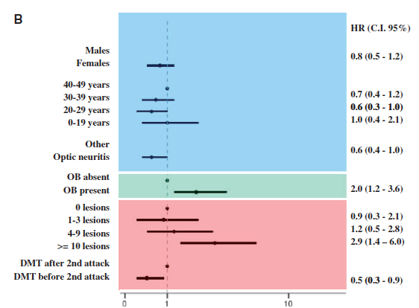
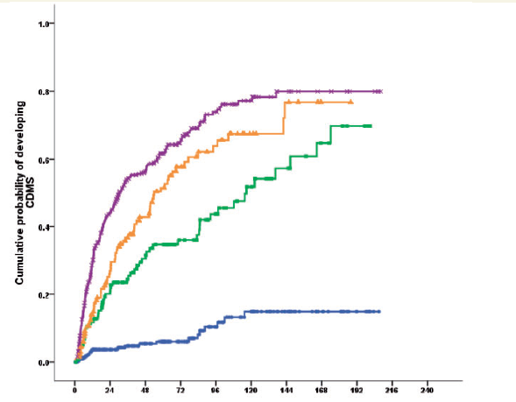
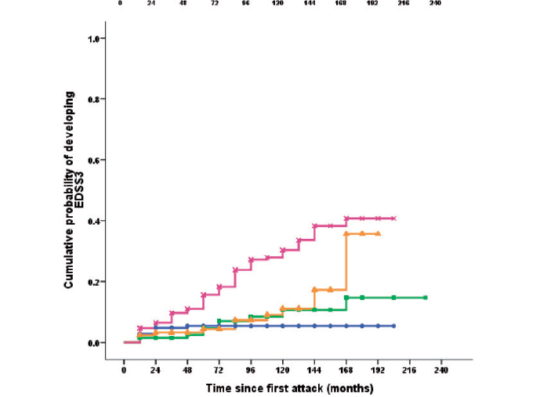
Relevance on Conversion to CDMS
Relevance on getting to EDSS 3.0
≥10 lesions
4-10 lesions
1-3 lesions
≥10 lesions
4-10 lesions
0 lesions
1-3 lesions
0 lesions

Slide 7
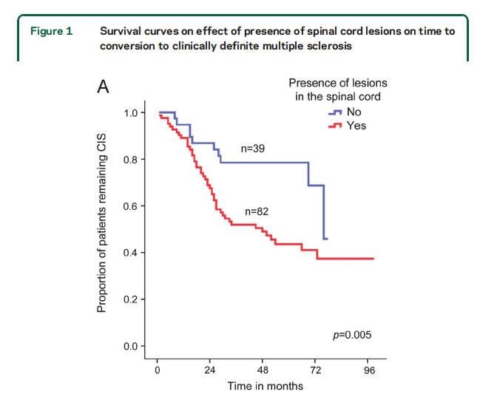
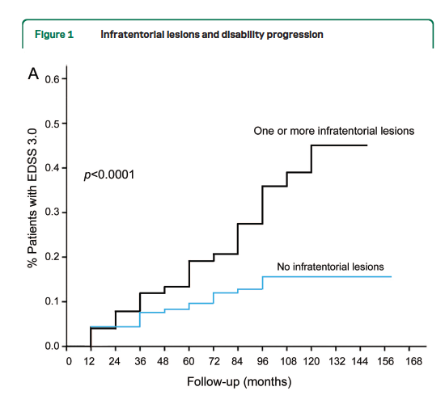
Relevance of lesion location
Sombekke et al Neurology 2013
Tintore et al Neurology 2010

Slide 8
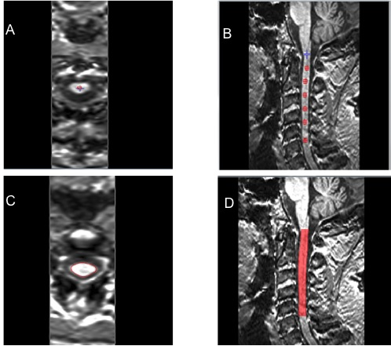
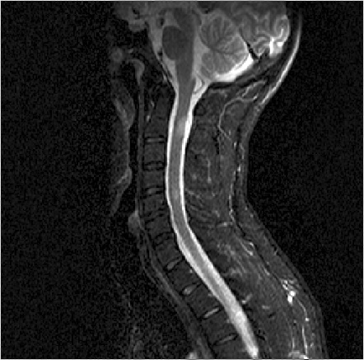
Brain and spinal cord atrophy measures
Metrics of global brain atrophy (brain parenchymal volume or fraction).
Metrics of regional brain volumes, such as WM and GM.
Trials in PPMS or SPMS have used the change in cord area as a secondary end point.
Kaunzner U et al. 2017; Tur C et al, Nat Reviews 2018; Giorgio a et al. Neur Clin 2018

Slide 9
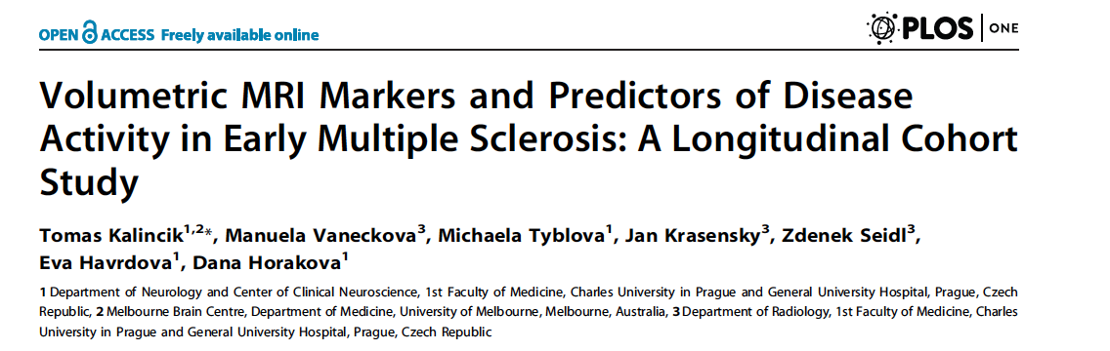
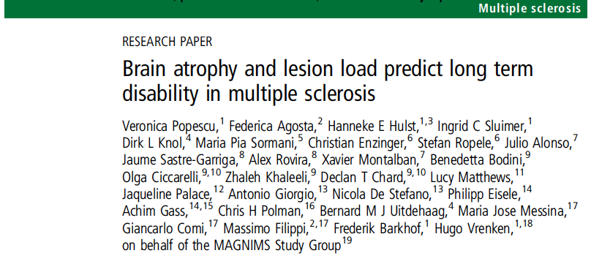
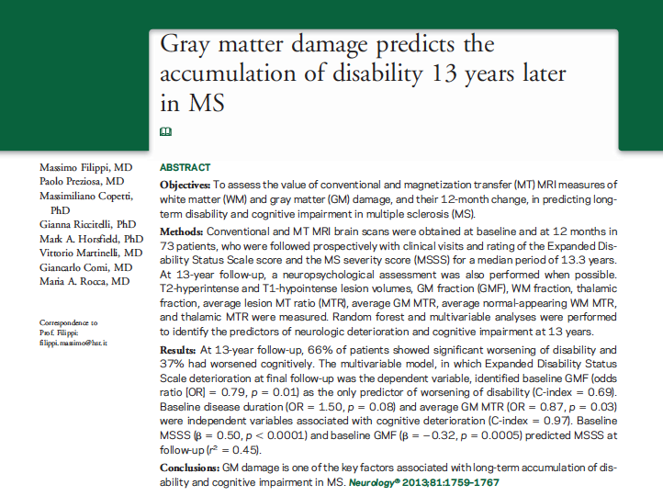
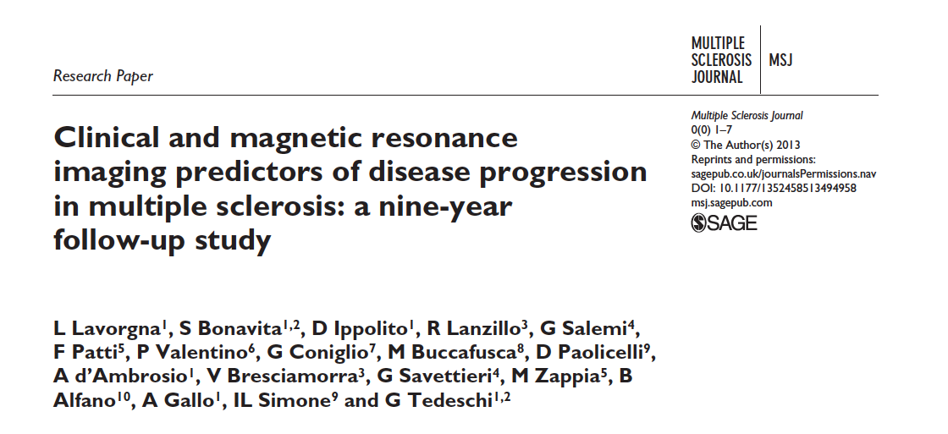
Brain atrophy as predictor of prognosis
6-month callosal atrophy and greater baseline T₂LV predicted conversion to CDMS within 2 years
2-year central atrophy and lesion volume change as predictors of EDSS after 10 years
Baseline GM fraction as the only predictor of worsening of disability at 13 years
Baseline GM volume and EDSS as the best predictors of progression (conversion to SP, EDSS 4) after 9 years in RRMS

Slide 10
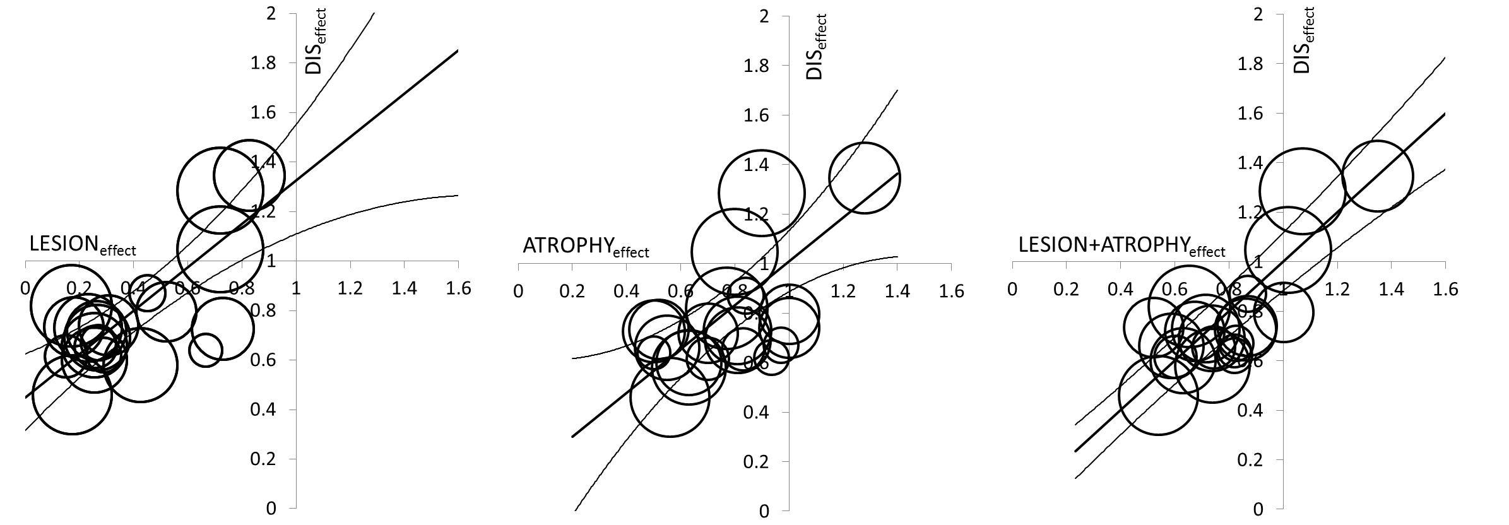
Meta-analysis of Randomised Clinical Trials in RRMS:
lesions, brain atrophy and clinical disability
Meta-analysis of 13 RCTs (13500 RRMS patients)
R² = 0.61, p<0.001
R² = 0.48, p<0.001
R² = 0.75, p<0.001
Lesion effect
Atrophy effect
Lesion + Atrophy effect

Slide 11
Pseudoatrophy is observed in the first 6-9 months of treatment with the majority of DMTs
Treatment duration (months)
0
6
12
24
36
untreated patients
-0.5%
Zone of
prevention
low-dose IFNβ ¹⁻³
high-dose IFNβ and chemotherapeutics⁴⁻⁷
-1.0%
Net brain parenchymal volume loss
glatiramer acetate⁸⁻⁹
-1.5%
Zone of
pseudoatrophy
natalizumab ^{10,11}
≥2.0%
Zone of
irreversible
atrophy
  Pseudoatrophy mimics brain volume changes caused by tissue loss
  Possible causes include:
    resolution of inflammation and oedema
    changes in electrolyte balance and vascular permeability or dehydration
From: Zivadinov R, et al. J Neurol.; 1. Filippi M, et al. Lancet 2004, 2. Hardmeier M, et al. Neurology 2005; 3. Rudick RA, et al. Neurology 1999; 4. Jones C, et al. Neurology 2001; 5. Chen JT, et al. Neurology 2006; 6. Inglese M, et al. J Neurol Neurosurg Psychiatry 2004; 7. Roccatagliata L, et al. Mult Scler 2007; 8. Ge Y, et al. Neurology 2000; 9. Sormani MP, et al. Neurology 2004; 10. Fisher E, et al. J Neurol 2005; 11. O’ Connor PW, et al. Abstract presented at ANN 2006
Notes:
11
Natural history and placebo-controlled studies of brain atrophy in MS patients show a rate of ~1% brain atrophy per year¹
For the majority of DMTs, patients show a slight decrease in brain volume in the first 6-9 months after treatment, known as pseudoatrophy¹
Pseudoatrophy mimics brain volume changes caused by tissue loss, but is thought to be caused by resolution of inflammation and oedema, changes in electrolyte balance and vascular permeability or dehydration²
1. Zivadinov R et al. J Neurol 2008
2. Zivadinov R et al. Neurol 2008
11

Slide 12
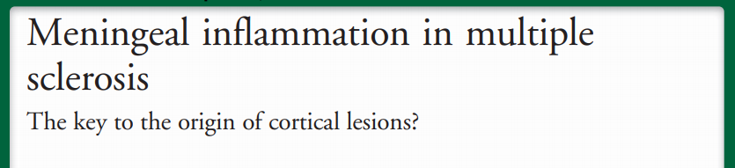
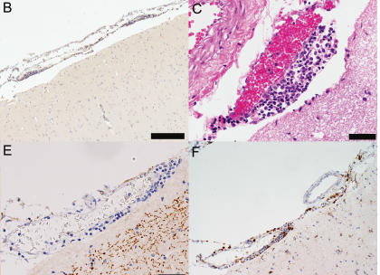
Leptomeningeal enhancement (LME)
LME (B cell-rich) twice as frequent (33%) in patients with progressive than RR (19%) forms of MS.
Present in 44 patients with SPMS and 74 patients with PPMS.
Related to subpial cortical lesions and atrophy.
Demyelination, cortical atrophy, and leptomeningeal inflammation may provide a new therapeutic target in P-MS
Eisele P, Neurology 2015; Absinta M, Neurology 2015; Zivadinov R MS Journal 2016
Meningeal inflammation is topographically associated with cortical demyelination in early MS
Popescu and Lucchinetti, Neurology 2017

Slide 13
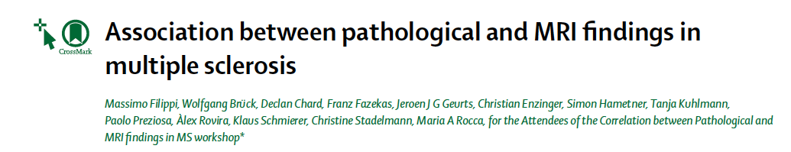
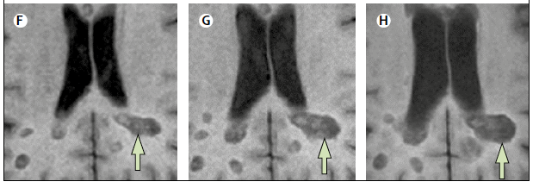
Slowly Expanding Lesion (SEL)
A candidate biomarker for smoldering inflammation in MS

Slide 14
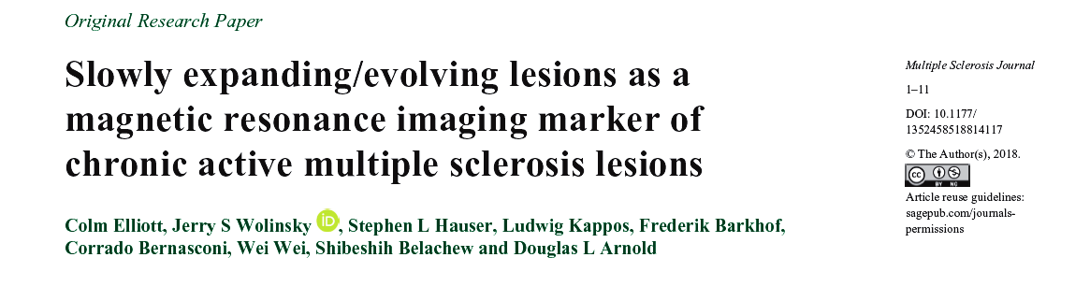
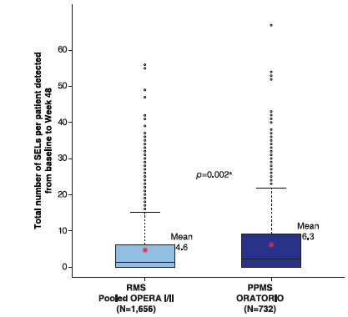
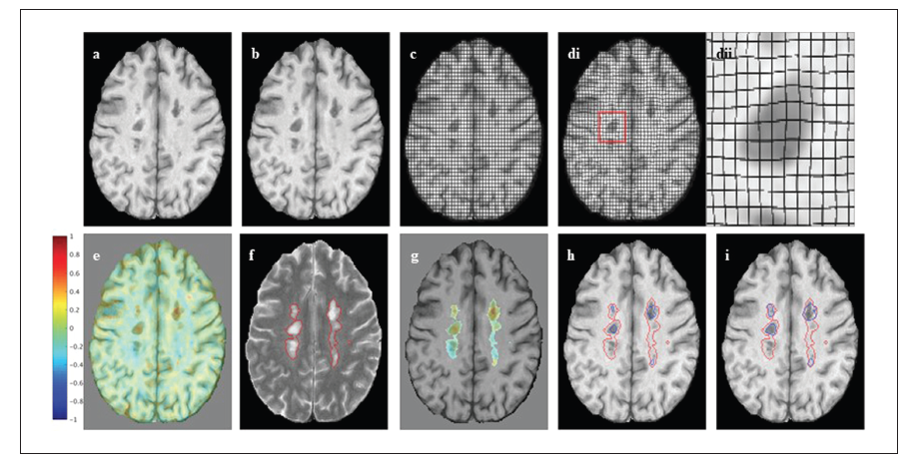

Slide 15
Assessment of treatment response
Disease progression
Disability
Relapses
MRI activity
Focal inflammation
(relapses / MRI lesions)
Diffuse damage accumulation
(neurodegeneration / failure of repair; disability / atrophy)

Slide 16
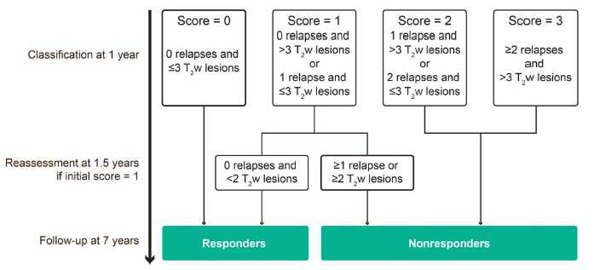
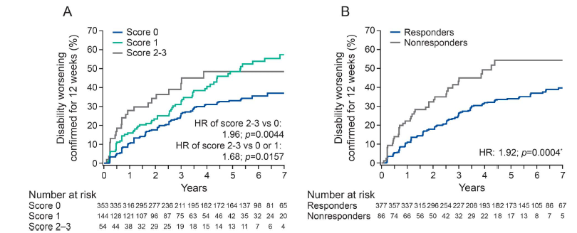
Individual patient response
Sormani et al., Neurol Neuroimmunol Neuroinflamm 2017

Slide 17
No evidence of disease activity (NEDA)
NEDA3
no 12-week confirmed disability progression
no protocol-defined relapses
no new/enlarging T₂ lesions
no T₁ gadolinium enhancing lesions
NEDA4
No loss of brain volume
Comprehensive measure of overall treatment benefit.
Used to assess positive treatment response for patients with RRMS after 2 years.
It is an evolving measure and there are conflicting studies regarding the prognostic potential of NEDA3 for long-term disease stability.
Bevan CJ. Jama Neurol 2014; Giovannoni G. Multiple Sclerosis and Related Disorders 2015

Slide 18
NEDA is achievable with existing
MS therapies
Data cannot be directly compared between trials because
of distinct study designs and/or patient populations
***
***
***
*
***
**
***
Patients achieving NEDA (%)
***
*
**
OPERA I¹
Ocrelizumabª
vs sc IFN beta-1a
^{Sponsored by Genentech}
OPERA II¹
Ocrelizumabª
vs sc IFN beta-1a
^{Sponsored by Genentech}
CLARITY²
Cladribine
Tablets
vs placebo
CARE-MS I³
Alemtuzumab
vs sc IFN beta-1a
^{Sponsored by Sanofi}
AFFIRM⁴
Natalizumab
(Tysabri®)
vs placebo
^{Sponsored by Biogen}
FREEDOMS⁵
Fingolimod
vs placebo
^{Sponsored by Novartis}
CARE-MS II⁶
Alemtuzumab
vs sc IFN beta-1a
^{Sponsored by Sanofi}
DECIDE⁷
Daclizumab
(Zinbryta®)
vs im IFN beta-1a
^{Sponsored by Biogen}
DEFINE⁸
Dimethyl fumarate
vs placebo
^{Sponsored by Biogen}
TEMSO⁹
Teriflunomide
vs placebo
^{Sponsored by Sanofi}
*p<0.05, **p<0.001, ***p<0.0001 study drug vs comparator. ªOcrelizumab is approved for the treatment of MS in the US only. NEDA defined as no relapses, no 3-month confirmed CDP, and no new T1 Gd+ lesions and no new enlarging or enlarged T2 lesions on cranial MRI (except CLARITY, CARE-MS I and CARE-MS II: based on no 6-month CDP). CDP, confirmed disability progression; Gd+, gadolinium-enhancing; IFN, interferon; im, intramuscular; MRI, magnetic resonance imaging; NEDA, no evidence of disease activity; sc, subcutaneous
1. Traboulsee A et al. Neurology 2016;86 [PL02.004]; 2. Giovannoni G et al. Lancet Neurol 2011;10:329‒37; 3. Cohen AJ et al. Lancet 2012;380:1819–28; 4. Havrdova E et al. Lancet Neurol 2009;8:254‒60; 5. Bevan CJ, Cree BA. JAMA Neurol 2014;71:269‒70; 6. Coles AJ et al. Lancet 2012;380:1829–39; 7. Kappos L et al. AAN 2016 [115]; 8. Giovannoni G et al. Neurology 2012;78 [PD5.005]; 9. Freedman M et al. Neurology 2012;78 [PD5.007]

Slide 19
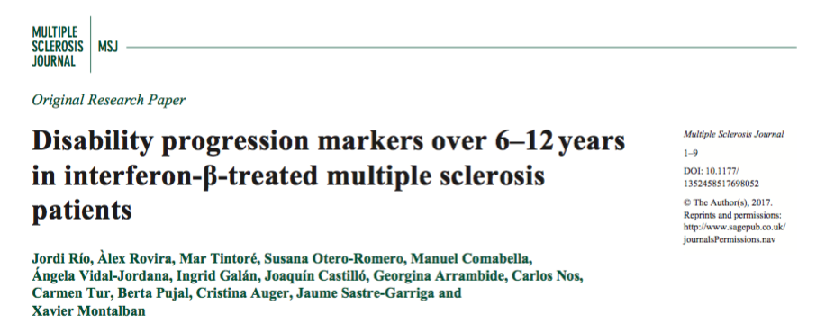
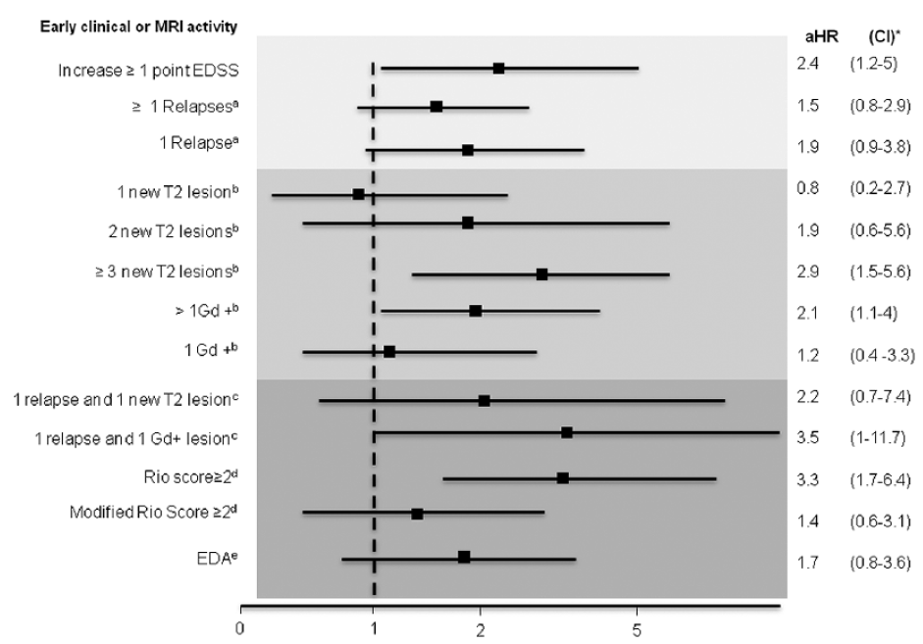
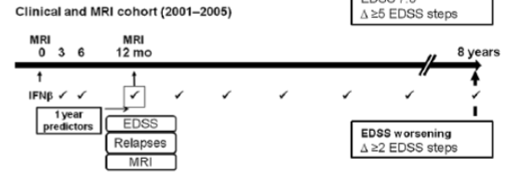
Minimal evidence of disease activity (MEDA)
233 patients
The presence of one or two new T₂ lesions does not pose a significant risk of long-term disability
Significant MRI activity (⩾ 3 new T₂ or ⩾ 2 Gd-enhancing lesions) at 12 months clearly predicts a poor long-term outcome
Rio et al., Mult Scler J 2017

Slide 20
No evidence of progression or active disease
(NEPAD)
No 12-week confirmed progression of ≥1/≥0.5 points on the EDSS if the baseline score was ≤ 5.5/>5.5 points, respectively
No 12-week confirmed progression of ≥20% on the T-25FW and 9-HPT test
no new/enlarging T₂ lesions
no T₁ gadolinium-enhancing lesions
no protocol-defined relapses
Wolinsky J et al. Ann Neurol 2018;84:527–536

Slide 21
NEPAD in Patients With PPMS
ORATORIO Trial
Wolinsky J et al. Ann Neurol 2018

Slide 22
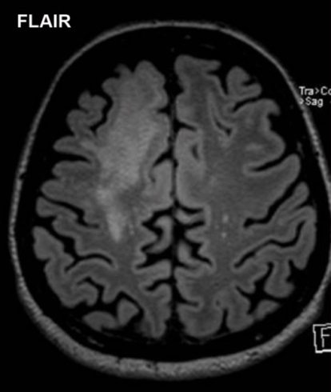
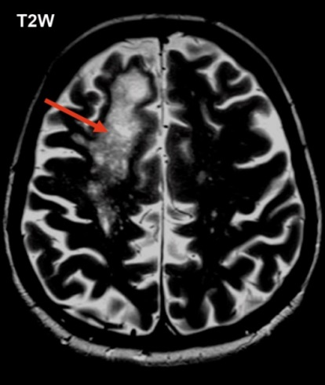
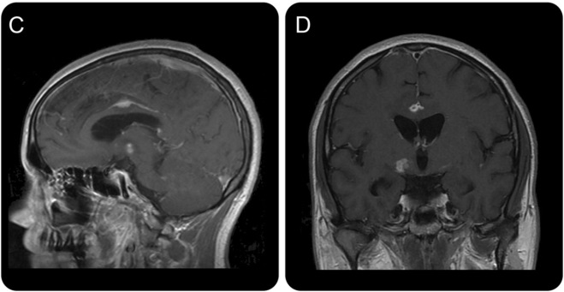
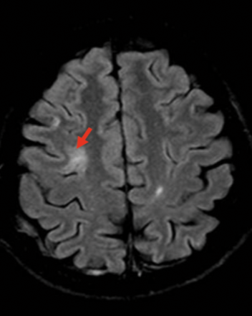
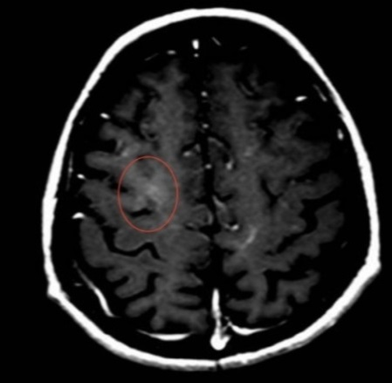
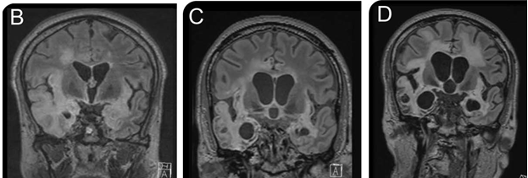
Side Effects
PML (Natalizumab)
Cryptococcosis (Fingolimod)
DeRen, Neurology 2015
HSV-1 (Fingolimod)
Pfender, Neurology 2015

Slide 23
Diagnosis of Natalizumab-associated progressive multifocal leukoencephalopathy using MRI
Mike P. Wattjes and Frederik Barkhof Curr Opin Neurol 2014
In MS, the incidence of PML is greatest with Natalizumab, but there have been cases reported with newer oral medications, such as DMF and Fingolimod.
Differentiation between PML and new MS lesions can be difficult but specific MRI features can help.
MRI monitoring for patients on these treatments is crucial to detect PML prior to fulminant clinical symptoms.
Early detection increases survival.
Notes:
In recent years, the use of MRI has gained more
relevance for the detection of adverse effects associated
with available newer treatment options.
Important is the monitoring of immunesuppressive
medication and the associated disease
progressive multifocal leukoencephalopathy
(PML)
Slide provided by client

Slide 24
TIME | INITIAL 12 MONTHS | AFTER 12 MONTHS
Patient with continuosly negative JC antibody | No additional safety monitoring within the first 12 months. Obtain regular MRls to monitor treatment effects | Obtain MRls every 12 months
Patient becomes positive for JC antibody (titer <1.5) | No additional safety monitoring within the first 12 months required. Obtain regular MRls to monitor treatment effects | Obtain MRl surveillance scans every 6 months (minimum) (minimum sequences: T2, DWI and FLAIR)
Patient becomes positive for JC antibody (titer >1.5) | No additional safety monitoring within the first 12 months required. Obtain regular MRls to monitor treatment effects | Obtain MRl scans every 3-4 months (minimum sequences: T2, DWI and FLAIR)
Kaunzner U and Gauthier S Ther Adv Neurol Disord 2017
Notes:
Slide provided by client

Slide 25
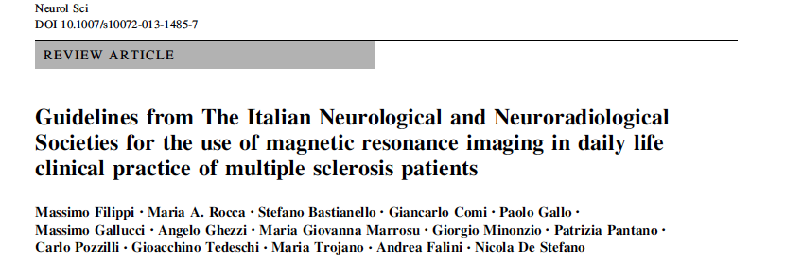
Guidelines on the use of MRI in MS
CIS | RRMS (Following treatment initiation)
Baseline | 6 months
3 months | 12 months
1 year | 24 months
 | 36 months
 | Then every 2 years (if clinically stable)
Follow-up scans should be performed in the same scanner with identical parameters, particularly slice position,
Scan acquisition time should be 25–30 minutes.
At least a 1.0 T magnet should be used.
Slice thickness should not exceed 5 mm
(3 mm is recommended),
Scanning frequency

Slide 26
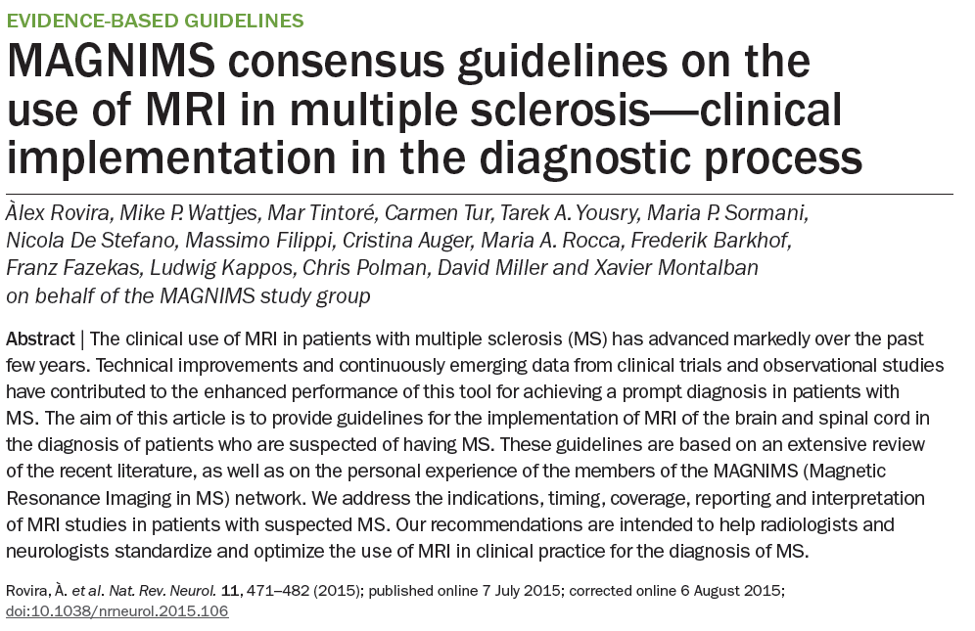
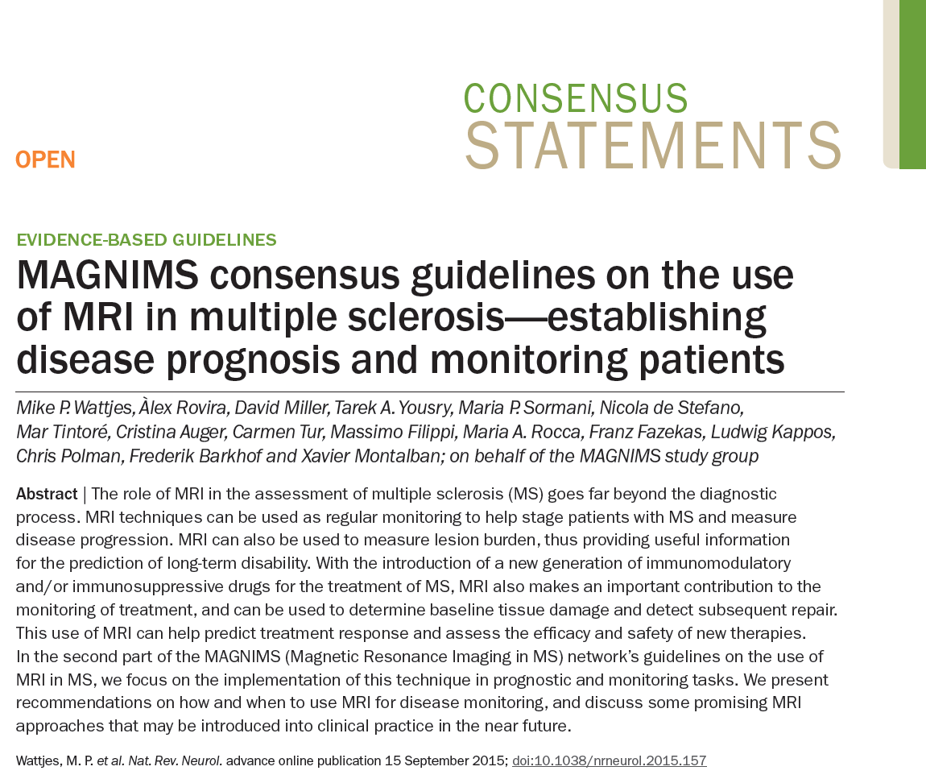
MAGNIMS consensus guidelines on the use of MRI in MS

Slide 27
MAGNIMS guidelines
Brain Imaging
Recommendation | Baseline evaluation | Follow-up examinations
Field strength | >1.5 T (preferably 3.0 T) | >1.5 T (preferably 3.0 T)
Slice thickness | ≤3 mm | ≤3 mm
In plane spatial resolution | ≤1 x 1 mm | ≤1 x 1 mm
Brain MRI | Axial PD and/or T2w/T2-FLAIR — Sagittal 2D/3D T2-FLAIR — Axial 2D or 3D contrast-enhanced T1w | Axial PD and/or T2w/T2-FLAIR — Axial 2D or 3D contrast-enhanced T1w
Optional brain MRI | Unenhanced 2D or high-resolution isotropic 3D T1w — 2D and/or 3D dual inversion recovery Axial DWI | Unenhanced 2D or high-resolution isotropic 3D T1w — 2D and/or 3D dual inversion recovery
Delay between Gd injection and scanning | ≥5 mins | ≥5 mins
Rovira et al., Nat Rev Neurol 2015

Slide 28
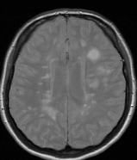
Standardized MRI protocol/Timing
Pre-treatment Re –baseline 6 months Follow-up every 12 months
Re-baseline 6 months
Treatment onset
0
0
1
Unscheduled MRI scan if required
  Safety
  Suspected comorbidity
  Confirmed relapses/progression (if impact on therapy)
Additional scans required for relapsed treatment-related adverse events (PML)
  Brain only (spinal cord MRI only in some clinical situations)
Disease activity within the first weeks/months after treatment initiation not related to treatment failure:
  some time is required before the treatment becomes effective
  new T2 lesions are preceded by non-visible pathological changes (already present before treatment initiation)
disease evolution
treatment response
Freedman et al., Can J Neurol Sci 2013
Rovira et al., Ther Adv Neurol Dis 2013
Giovannoni et al., Mult Scler Relat Disord 2015
Notes:
28

Slide 29
Conclusions
Conventional MRI techniques have provided useful markers to monitor treatment effect in MS clinical trials.
The routine use of MRI is recommended to monitor disease activity during treatment (at an individual patient level):
    to facilitate early identification of those patients who could possibly benefit from a different therapeutic approach;
    to identify incipient signs of side effects;

Slide 30
Conclusions
  It is likely that in the near future novel MR metrics to assess treatment response in clinical trials and in daily-life practice will be proposed, validated and used.

Slide 31
Responsabile
Prof. Nicola De Stefano
Marco Battaglini (Physicist)
Giacomo Demurtas (IT)
Antonio Giorgio (MD)
Irina Efimenko (Coordinator)
Giordano Gentile (MSc)
Ludovico Lucchetti (MSc)
Riccardo Tappa Brocci (MSc)
Claudia Vinciguerra (MD)
Jian Zang (MD)

Slide 32


Slide 33
MRI characteristics of RR-MS and PP-MS
Brain
PP-MS
Fewer lesions
Lower rate of new lesion formation
Fewer Gd-enhancing lesions
RR-MS

Slide 34
MRI characteristics of RR-MS and PP-MS
Spinal cord
Often develop spinal cord pathology in terms of both lesion formation and spinal cord atrophy

Slide 35
MRI characteristics of RR-MS and PP-MS
Brain and Spinal cord
Dastagir A. et al. ENS 2018

Slide 36
Traditional Outcome Measures in MS
Clinical Course of MS¹
Traditional Clinical & MRI Measures³
CIS
Not active
Active
Relapse outcomes
Relapse rate
Disability outcomes
EDSS
MRI outcomes
New / enlarging T₂ lesions
New Gd⁺ lesions
Relapsing MS
RRMS
PPMS
Active with progression
Active without progression
Not active, with progression
Stable disease
Progressive MS
SPMS
Clinical trial outcomes were designed to capture changes associated with meaningful differences in patients’ health
Relapse rate and delay of disability progression assessed by EDSS are the only accepted primary endpoints in registration trials in RMS²
  MRI outcomes may be primary endpoints in Phase 2 MS trials but, are typically secondary/tertiary endpoints in Phase 3 studies³⁻⁵
1. Lublin F, et al. Neurology. 2014; 2. Sormani MP, et al. Ann Neurol. 2009; 3. Freedman MS. Can J Neurol Sci. 2013; 3. O'Connor PW, et al. Neurology. 2006 Mar 28;66(6):894-900; 4. Lavery AM, et al. Mult Scler Int. 2014; 5. Data on file. Genzyme, a Sanofi company.
.

Slide 37

The MS “Iceberg”–Time to Address the Subclinical Markers
Clinical symptoms
1
1
1
The current focus tends to be on parameters towards the “tip of the iceberg”:
ARR
EDSS
MRI
2
Documented relapses
Unreported relapses
Subclinical disease
Subclinical relapses
Focal MRI activity – new T2 lesions
and Gd-enhancing T₁ lesions
Cognitive deterioration
Focal grey and white matter lesions not detected by MRI
But we also need to address important subclinical markers such as:
Brain atrophy
Focal grey and white matter
Neurofilament levels
Brain atrophy and neurofilament levels
ARR: Annualised relapse rate; EDSS: Expanded disability status scale; MRI: Magnetic resonance imaging
Modified from Giovannoni G, et al. MSRD. 2016.9;S5–S48

Slide 38
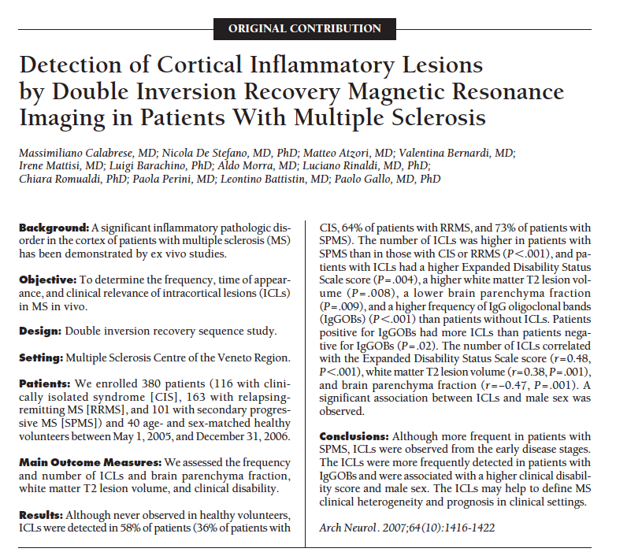
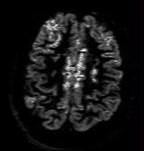
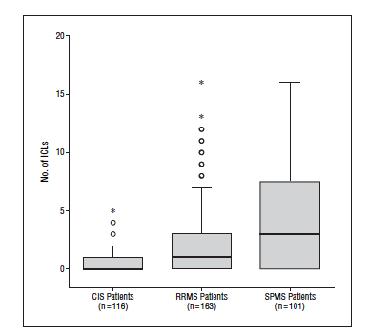
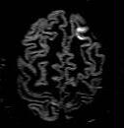

Slide 39
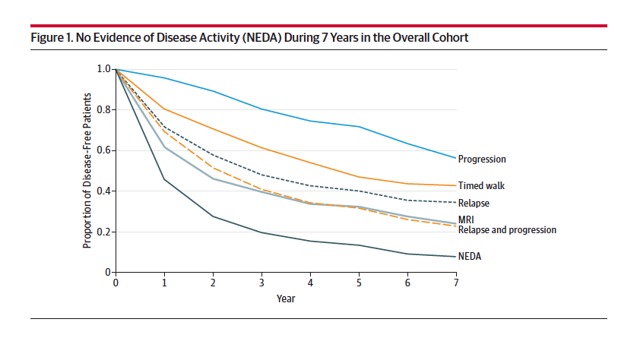
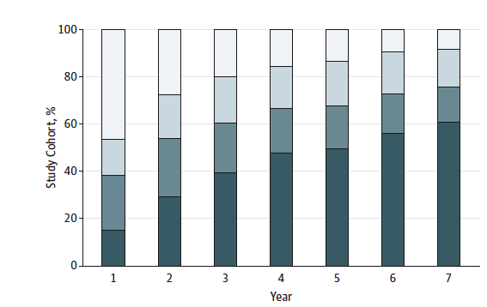
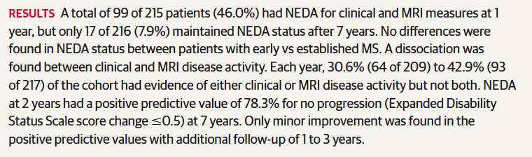
NEDA in Clinical Setting-Long-term FU (7y)
NEDA is difficult to sustain long-term even with treatment
(only 17 of 216, ≈8%) maintained NEDA status after 7 years.
Rotstein et al JAMA Neurol 2015
Notes:
Key takeaway:
There is an emerging understanding of MS pathology with increasing evidence for concomitant focal and diffuse damage
This creates the biological foundation for a modern treatment paradigm of NEDA-4
Fingolimod is a promising treatment option since it acts on both focal and diffuse damage and allows changing the course of MS

